Slide 1
Multiplayer shooting Game
Author: Maoxi Xu, Zhuowen Zhong

Slide 2

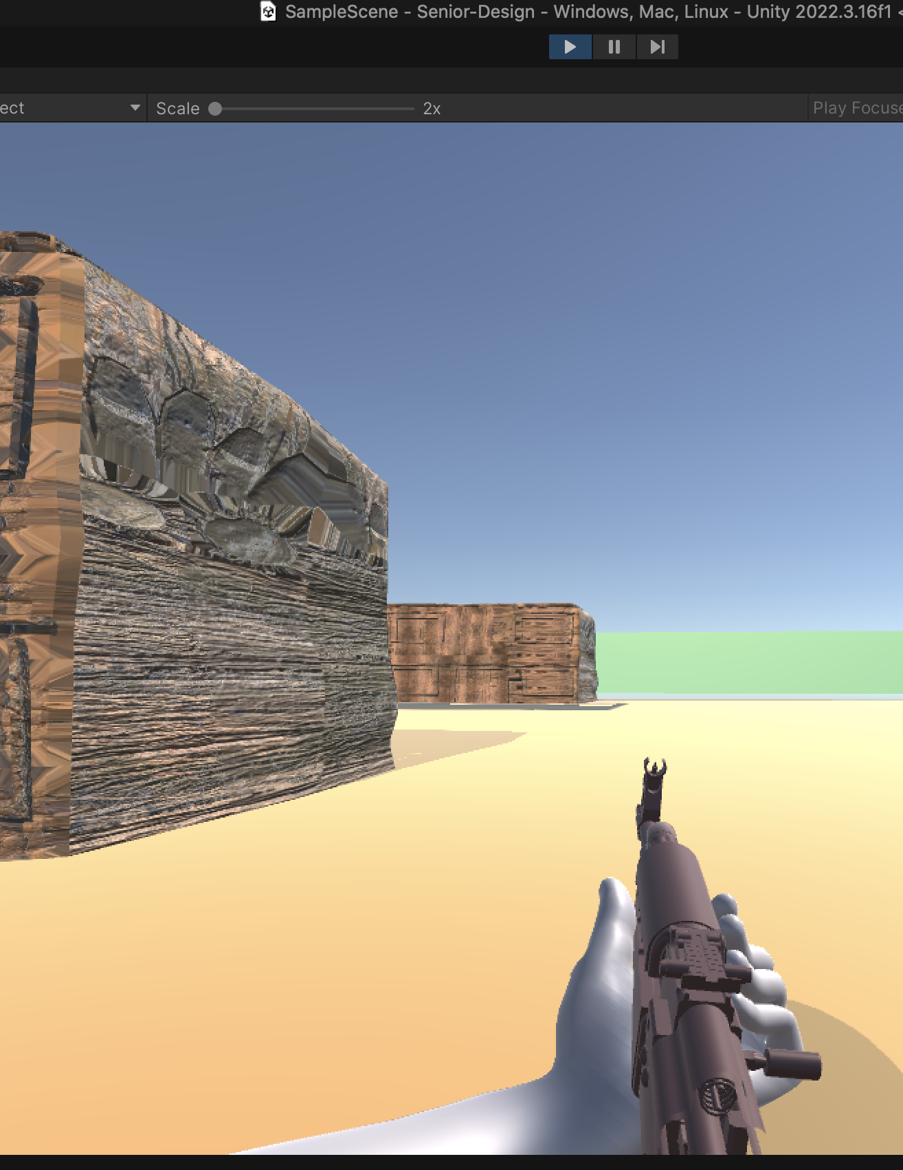
introduction
This is A multiplayer first-person shooter game based on Unity 3D and Photon. A multiplayer 3D shooting game that allows players to compete or collaborate with each other in real-time .

Slide 3

Framework
In our senior design, we are using unity and c# language to build our multiplayer shooting game and use pun to connect the client to server.

Slide 4
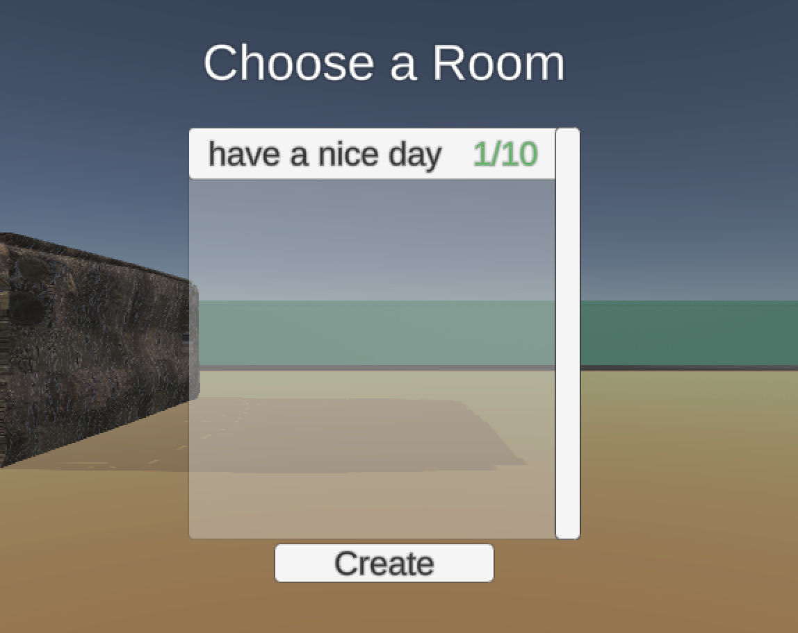
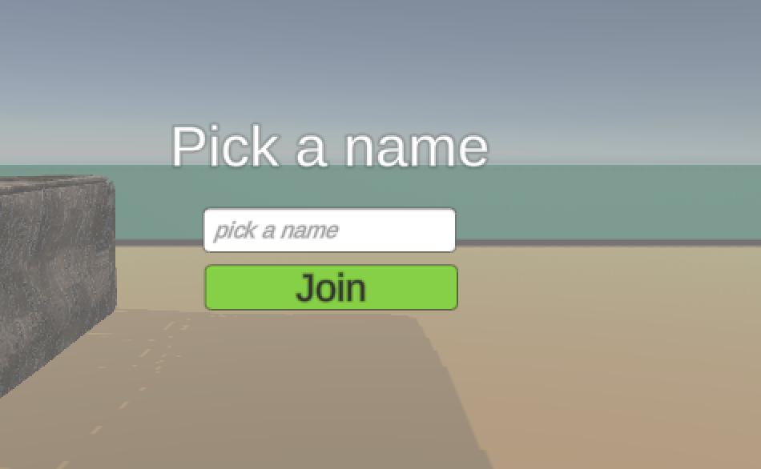
Join other room or create your room
Join Room: Users select this option if they want to join an existing game room. They might be presented with a list of available rooms, each with its topic, and current user amount. After selecting a room, users are connected to that room's interface. Create Your Room: Users choose this option if they want to create a new game room. They might to enter a name for the room .
Input your player's name to join the room
This instruction allows users to enter their chosen username or player name. This name will be displayed to others in the game room. After entering a name, users can proceed to join an existing room or their own room.
Login panel

Slide 5
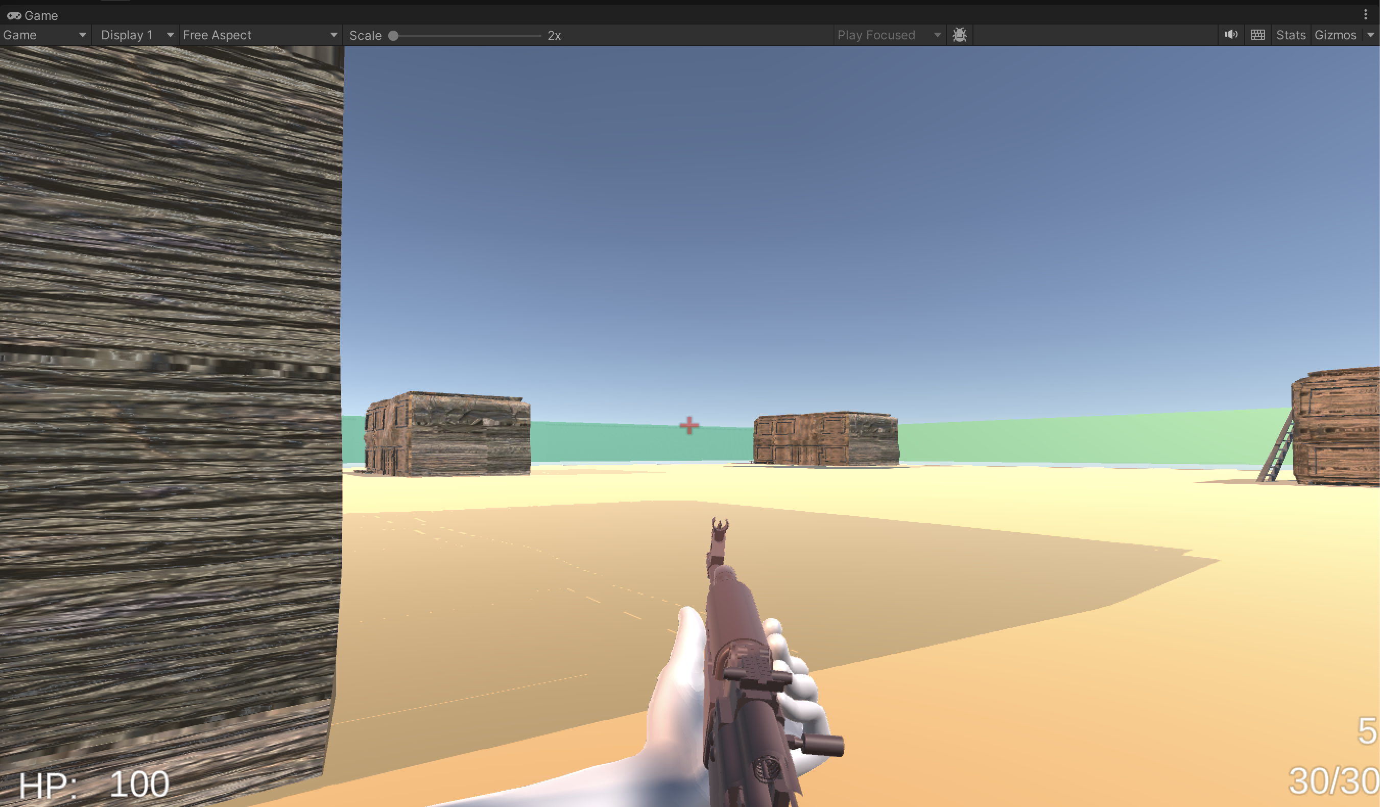
Game interface
Player's HP on the bottom left corner
The gun information on the bottom right corner, which shows status of gun(which is magazine and ammo amount)
A gun (AK-47) is always shown on the lower center in front of everything you can see
A red shooting sight is always in the center of the screen

Slide 6
Player Movement
Walk & Run
Jump
Shooting
Reload ammo

Slide 7
Walk & Run
By pressing the (WASD) 4 keys on the keyboard, you can control the character to move forward, backward, left, and right in the map.
When you press the shift button in conjunction with the movement keys, the movement speed will become faster(like run )

Slide 8
Jump
Jump Height Calculation: The jump height in the game is determined by applying a vertical force to the character's Rigidbody component when the player initiates a jump action.
Physics-Based Calculation: By utilizing basic physics principles, the game calculates the jump height by considering factors such as the size of the initial vertical velocity and the acceleration due to gravity.
Adjustment for Realism: To achieve a realistic and better jump experience, the game adjusts the calculated jump height by fine-tuning parameters such as jump force and gravity strength.

Slide 9
shooting
Fire Rate Control: The game enforces a fire rate limit to prevent rapid firing, ensuring a balanced gameplay experience.
Hit Detection and Effects: when firing, a raycast is cast from the player's camera to detect collisions with objects in the scene. If a collision occurs, a hit visual effect (VFX) is instantiated at the hit point to simulate bullet impact.
Recoil Simulation: To simulate weapon recoil, the weapon's position is adjusted based on recoil parameters such as recoil up and recoil back. Recoil and recovery animations are smoothly interpolated to provide a realistic shooting experience.

Slide 10
Reload ammo
Reload Animation: pressing the 'R' key, the weapon initiates a reload animation, providing visual feedback to the player that the reloading process has been initiated.
Ammo Display Update: The UI elements displaying gun information, such as the current magazine count (mag) and remaining ammo reserve (amo), are dynamically updated to reflect the changes resulting from the reload action.

Slide 11
Game logic
Player control
Shooting mechanic
Score system
Respawn system

Slide 12
PLAYER CONTROL
The Movement.cs script manages the player's movement and jumping mechanics within the game. It leverages Unity's physics system by interacting with the Rigidbody component to apply forces for movement and jumping, providing a physics-based experience.

Slide 13
SHOOTING MECHANIC
Projectile and Hit Detection: Upon firing, the script casts a ray from the camera forward to detect hits. If an object is hit, it checks for a Health component on the hit object to apply damage. If damage results in the health dropping to zero or below, additional score points are added, and potentially other game-specific interactions are triggered (like increasing the kill count).
Effects and Network Synchronization: When an object is hit, a visual effect is instantiated at the hit location using Photon's network instantiation to ensure it appears across all clients. Damage application and score updates are also managed through Photon's networking, ensuring that all players' views are consistent.

Slide 14
SCORE SYSTEM
Leaderboard: After killing a player, the score will increase one, and it will automatically show in the leaderboard, and if u kill by other players, and it will count your death once, also it will show up in the leaderboard.
The leaderboard will list how many people join in the game with their name that created in the beginning, sorts it based on player scores in descending order.
The leaderboard is updated periodically at a specified refresh rate.
Additionally, if a player's custom properties contain information about kills and deaths, the kill/death ratio is displayed in the format "kills/deaths".

Slide 15
RESPAWN SYSTEM
The respawn system in the RoomManager script for a multiplayer game using Photon Unity Networking (PUN) is designed to manage the spawning of players into the game world when they join a room or possibly after they have been eliminated.

Slide 16
WYSIWIS ALGORITHM
Still have little delay in our game
Used majority voting method but still have issues with it.
Action Confirmation: When an event or action occurs (like shooting or moving), each client reports its version of the event based on its local game state. These reports are sent to either a central server or distributed among peer clients.
Voting on Events: Clients vote on the outcome of events based on their observations. For example, if there’s a dispute about whether a player was hit by a projectile, each client submits their observation, and the majority decision is accepted as the truth.

Slide 17
Q&A from classmate
what would you say are next steps for this project?
Our design is not completed, we still need to implement exit for the game.
Make better UI for the game
Make a final score point for this game, like when the player reaches the final point, and then he wins the game
For the weapons that player use in-game, we can make it flexible so that the player can choose what kinds of weapons he want to use
Create the armor for the user, also we can make an economy system, for example, like when you kill a player, you can get bonus and update your weapon
How do you propose introducing this artificial delay to your code?
Maybe use loop
At this point, because we are using photon pun 2 to implement the WYSIWIS, and then we can use OnPhotonSerializeView implementation to try to make the artificial delay

Slide 18

Demo Time

Slide 19
Individual part
Maoxi Xu:
Set up server
Set up the player's button
Room management system
Set nickname display
Score board system
Respawn system
Login panel
Zhuowen Zhong:
Player's movements
Animation of movements
Bullet mechanic
Game interface

